Slide 1

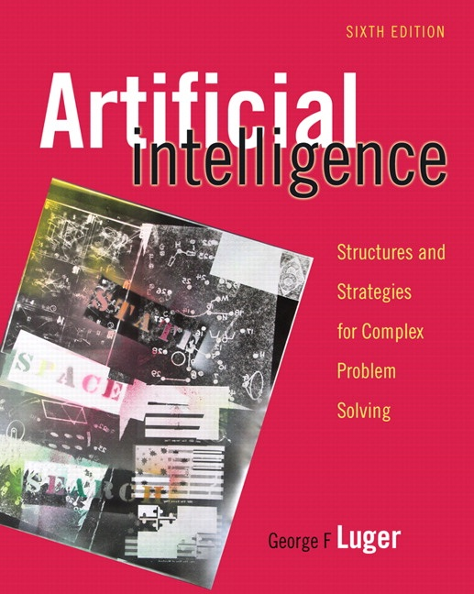
Machine Learning: Social and Emergent
12.0 Social and Emergent Models of
Learning
12.1 The Genetic Algorithm
12.2 Classifier Systems and Genetic
Programming
12.3 Artificial Life and Society-Based Learning
12.4 Epilogue and References
12.5 Exercises
George F Luger
ARTIFICIAL INTELLIGENCE 6th edition
Structures and Strategies for Complex Problem Solving
Luger: Artificial Intelligence, 6th edition. © Pearson Education Limited, 2009
1

Slide 2
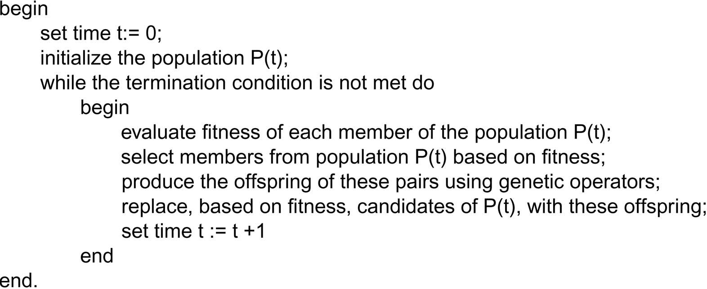
A general form of the genetic algorithm.
Luger: Artificial Intelligence, 6th edition. © Pearson Education Limited, 2009
2

Slide 3
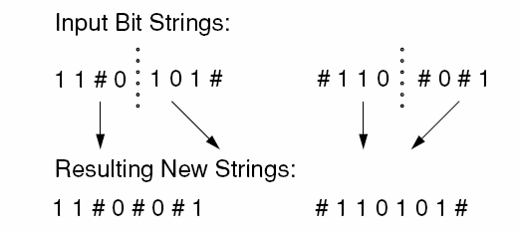
Fig 12.1 Use of crossover on two bit strings of length eight. # is “don’t care.”
Luger: Artificial Intelligence, 6th edition. © Pearson Education Limited, 2009
3

Slide 4
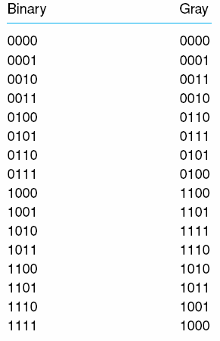
Table 12.1 The gray coded bit patterns for the binary numbers 0, 1, …, 15.
Luger: Artificial Intelligence, 6th edition. © Pearson Education Limited, 2009
4

Slide 5
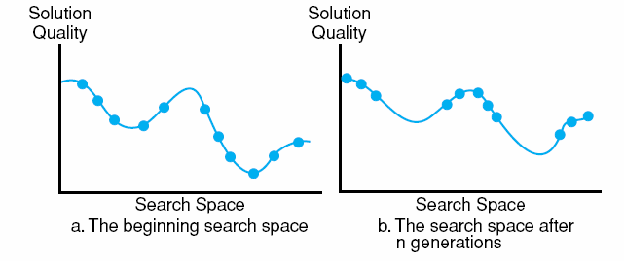
Fig 12.2 Genetic algorithms visualized as parallel hill climbing, adapted from Holland (1986).
Luger: Artificial Intelligence, 6th edition. © Pearson Education Limited, 2009
5

Slide 6
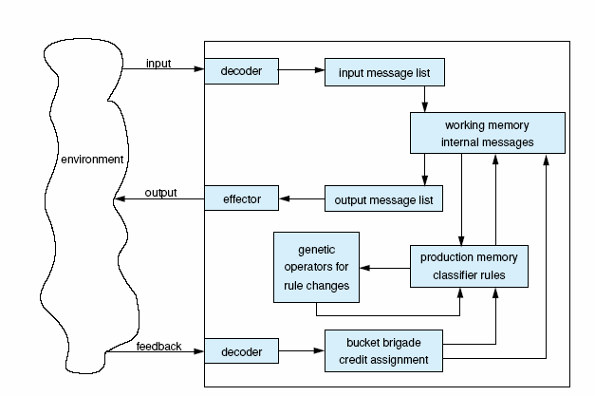
Fig 12.3 A classifier system interacting with the environment, adapted from Holland (1986).
Luger: Artificial Intelligence, 6th edition. © Pearson Education Limited, 2009
6

Slide 7
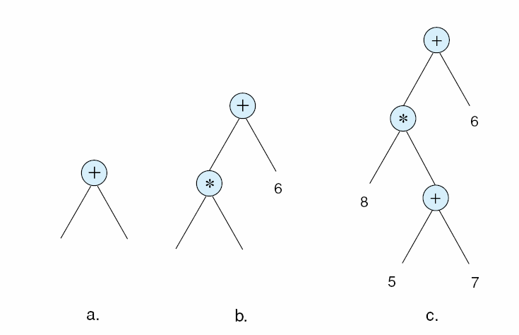
Fig 12.4 The random generation of a program to initialize. The circled nodes are from the set of functions.
Luger: Artificial Intelligence, 6th edition. © Pearson Education Limited, 2009
7

Slide 8
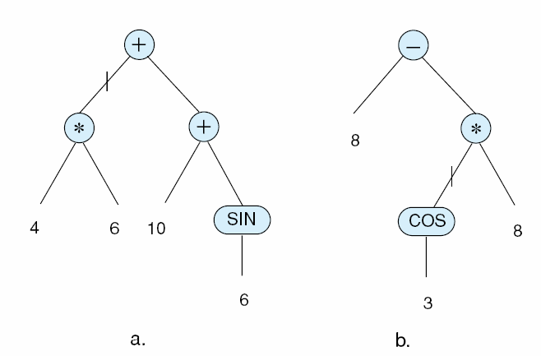
Fig 12.5 Two programs, selected on fitness for crossover. Points | from a and b are randomly selected for crossover.
Luger: Artificial Intelligence, 6th edition. © Pearson Education Limited, 2009
8

Slide 9
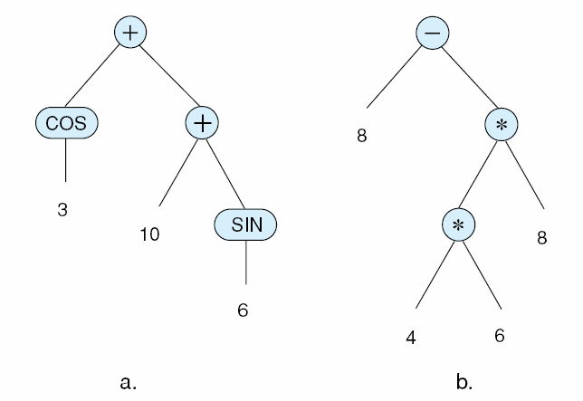
Fig 12.6 The child programs produced by crossover of the points in Fig 12.5.
Luger: Artificial Intelligence, 6th edition. © Pearson Education Limited, 2009
9

Slide 10
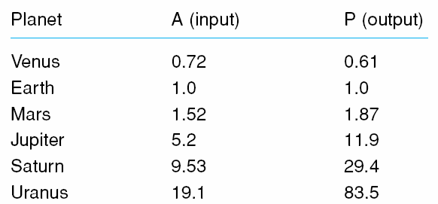
Table 12.3 A set of fitness cases, with planetary data taken from Urey (1952). A is Earth’s semi-major axis of orbit and P is in units of Earth-years.
Luger: Artificial Intelligence, 6th edition. © Pearson Education Limited, 2009
10

Slide 11
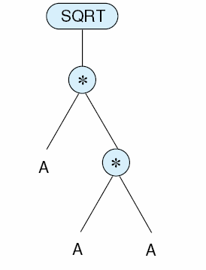
Fig 12.7 The target program relating orbit to period for Kepler’s third law.
Luger: Artificial Intelligence, 6th edition. © Pearson Education Limited, 2009
11

Slide 12
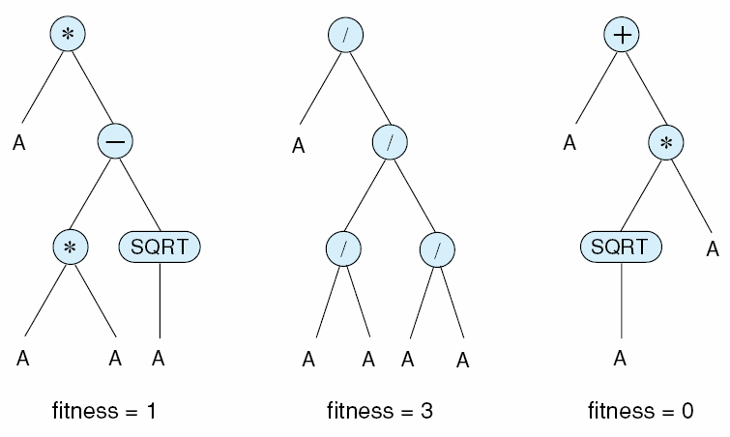
Fig 12.8 Members from the initial population of programs to solve the orbital period problem.
Luger: Artificial Intelligence, 6th edition. © Pearson Education Limited, 2009
12

Slide 13
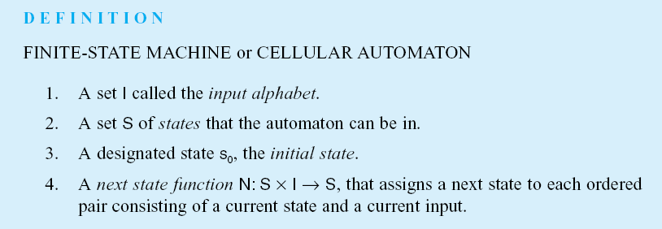
Luger: Artificial Intelligence, 6th edition. © Pearson Education Limited, 2009
13

Slide 14
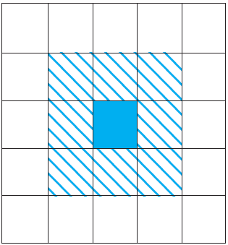
Fig 12.9 The shaded region indicates the set of neighbors for the “game of life.”
Luger: Artificial Intelligence, 6th edition. © Pearson Education Limited, 2009
14

Slide 15
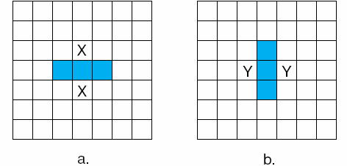
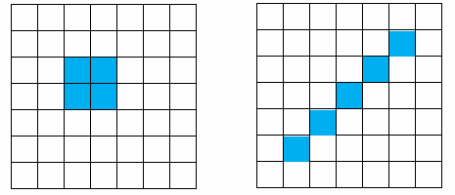
Fig 12.10 A set of neighbors generating the “blinking” light phenomenon.
Fig 12.11 What happens to these patterns at the next time cycle?
Luger: Artificial Intelligence, 6th edition. © Pearson Education Limited, 2009
15

Slide 16
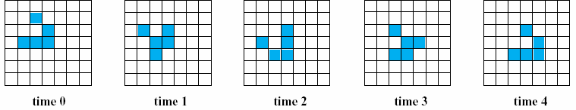
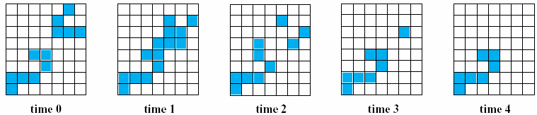
Fig 12.12 A “glider” moves across the display.
Fig 12.13 a “glider” is “consumed” by another “entity.”
Luger: Artificial Intelligence, 6th edition. © Pearson Education Limited, 2009
16

Slide 17
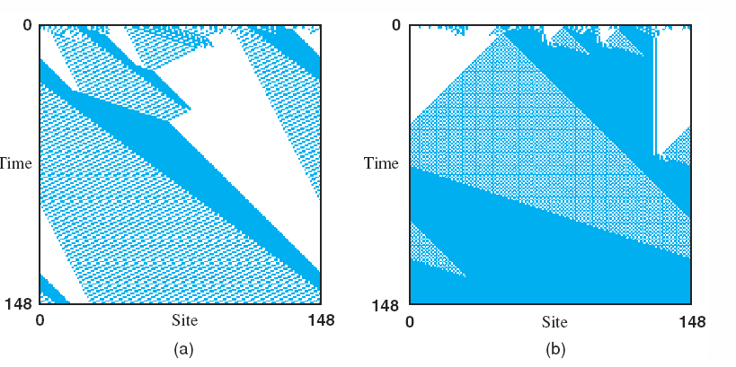
Fig 12.14 Space-time diagrams showing the behavior of two As., discovered by the genetic algorithm on different runs. They employ embedded particles for the nonlocal computation of general emerging patterns seen. Each space-time diagram iterates over a range of time steps, with 1s given as black cells, 0s as white cells; time increases down the page, from Crutchfield and Mitchell (1995).
Luger: Artificial Intelligence, 6th edition. © Pearson Education Limited, 2009
17

Slide 18
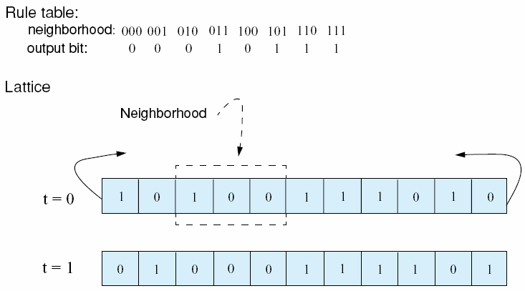
Fig 12.15 Illustration of a one-dimensional, binary-state, nearest-neighbor cellular automaton with N = 11. Both the lattice and the rule table for updating the lattice are illustrated. The lattice configuration is shown over one time step. The cellular automaton is circular in that the two end values are neighbors.
Luger: Artificial Intelligence, 6th edition. © Pearson Education Limited, 2009
18

Slide 19
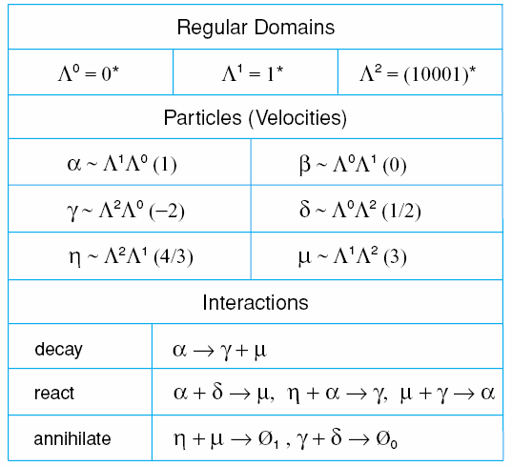
Table 12.4 Catalog of regular domains, particles (domain boundaries), particle velocities (in parentheses), and particle interactions of the space- time behavior of the CA of Figure 11.14a. The notation p ~ Λ^{x}Λ^{y} means that p is the particle forming the boundary between regular domains Λ^{x} and Λ^{y}.
Luger: Artificial Intelligence, 6th edition. © Pearson Education Limited, 2009
19

Slide 20
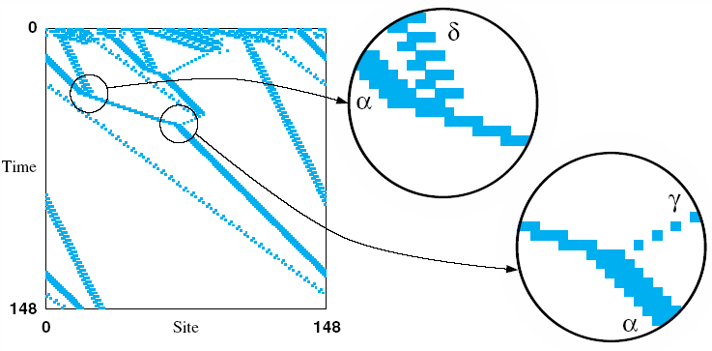
Fig 12.16 Analysis of the emergent logic for density classification of 11.14a.
This CA has three domains, six particles, and six particle iterations, as noted in Table 11.3. The domains have been filtered out using an 18-state nonlinear transducer; adapted from Crutchfield and Mitchell (1994).
Luger: Artificial Intelligence, 6th edition. © Pearson Education Limited, 2009
20

